Slide 1
Triggers in MySQL
Automatic execution of SQL in response to table events
Instructor: Sriya Ivaturi

Slide 2
Introduction to Triggers
A trigger is a named set of SQL statements
Executes automatically in response to INSERT, UPDATE, DELETE
Can run BEFORE or AFTER the event

Slide 3
When to Use Triggers
Automatically enforce rules
Track changes in audit tables
Maintain summary data
Validate or transform input data

Slide 4
Trigger Syntax
CREATE TRIGGER trigger_name
{BEFORE | AFTER}
{INSERT | UPDATE | DELETE}
ON table_name
FOR EACH ROW
BEGIN
-- trigger body
END;

Slide 5
Types of Triggers
BEFORE INSERT -> modify/validate data before inserting
AFTER INSERT -> log insertions
BEFORE UPDATE -> check/alter new values
AFTER UPDATE -> log changes, sync
BEFORE DELETE -> prevent deletion
AFTER DELETE -> archive/log old data

Slide 6
AFTER INSERT Trigger Example
CREATE TRIGGER after_student_insert
AFTER INSERT ON students
FOR EACH ROW
BEGIN
INSERT INTO audit_log(action, name)
VALUES ('New student added', NEW.name);
END;

Slide 7
BEFORE UPDATE – Compare OLD and NEW
CREATE TRIGGER before_salary_change
BEFORE UPDATE ON employees
FOR EACH ROW
BEGIN
IF NEW.salary < OLD.salary THEN
SIGNAL SQLSTATE '45000'
SET MESSAGE_TEXT = 'Salary decrease not allowed';
END IF;
END;

Slide 8
BEFORE UPDATE Trigger Example
CREATE TRIGGER before_name_update
BEFORE UPDATE ON employees
FOR EACH ROW
BEGIN
SET NEW.name = UPPER(NEW.name);
END;

Slide 9
Understanding NEW and OLD
`NEW`: new row value (INSERT or UPDATE)
`OLD`: existing row value (UPDATE or DELETE)
Use to compare, validate, or log data changes

Slide 10
When to Use NEW and OLD
INSERT: NEW ✅, OLD ❌
UPDATE: NEW ✅, OLD ✅
DELETE: NEW ❌, OLD ✅
Only use NEW in BEFORE to modify values
OLD is always read-only

Slide 11
Examples with NEW and OLD
BEFORE INSERT:
  SET NEW.name = UPPER(NEW.name);
BEFORE UPDATE:
  IF NEW.salary < OLD.salary THEN error;
AFTER DELETE:
  Log OLD.id and OLD.name into archive table

Slide 12
Rules for NEW and OLD
❌ Cannot assign to OLD
✅ Can assign to NEW only in BEFORE triggers
❌ NEW not available in DELETE
❌ OLD not available in INSERT

Slide 13
BEFORE INSERT – Modify NEW
CREATE TRIGGER before_insert_user
BEFORE INSERT ON users
FOR EACH ROW
BEGIN
SET NEW.name = UPPER(NEW.name);
-- Capitalize name
END;

Slide 14
AFTER INSERT Trigger Example
CREATE TRIGGER after_student_insert
AFTER INSERT ON students
FOR EACH ROW
BEGIN
INSERT INTO audit_log(action, name)
VALUES ('New student added', NEW.name);
END;

Slide 15
BEFORE UPDATE – Compare OLD and NEW
CREATE TRIGGER before_salary_change
BEFORE UPDATE ON employees
FOR EACH ROW
BEGIN
IF NEW.salary < OLD.salary THEN
SIGNAL SQLSTATE '45000'
SET MESSAGE_TEXT = 'Salary decrease not allowed';
END IF;
END;

Slide 16
AFTER UPDATE Trigger – Log Changes
DELIMITER //
CREATE TRIGGER after_name_update
AFTER UPDATE ON employees
FOR EACH ROW
BEGIN
-- Log the old and new name when it changes
IF OLD.name <> NEW.name THEN
INSERT INTO employee_changes (emp_id, old_name, new_name)
VALUES (OLD.id, OLD.name, NEW.name);
END IF;
END;
//
DELIMITER ;

Slide 17
BEFORE DELETE Trigger – Prevent Deletion
DELIMITER //
CREATE TRIGGER before_employee_delete
BEFORE DELETE ON employees
FOR EACH ROW
BEGIN
-- Prevent deletion of Managers
IF OLD.role = 'Manager' THEN
SIGNAL SQLSTATE '45000'
SET MESSAGE_TEXT = 'Cannot delete Managers';
END IF;
END;
//
DELIMITER ;

Slide 18
AFTER DELETE – Log OLD Data
CREATE TRIGGER after_delete_product
AFTER DELETE ON products
FOR EACH ROW
BEGIN
INSERT INTO deleted_products_log (product_id, name)
VALUES (OLD.id, OLD.name);
END;

Slide 19
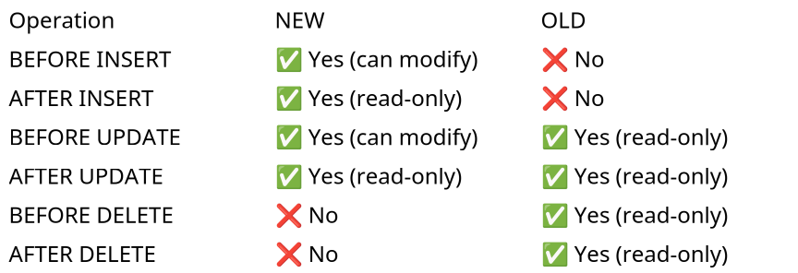
Summary Of New and Old

Slide 20
Things to Remember about NEW and OLD
🚫 You cannot assign values to OLD in any trigger.
✅ You can assign to NEW only in BEFORE triggers.
🚫 You cannot use NEW in DELETE triggers.
🚫 You cannot use OLD in INSERT triggers.
Triggers are row-level, so NEW/OLD refer to one row at a time.

Slide 21
Real Time Use Cases
Enforce business rules
Audit trails
Maintain consistency
Auto-formatting data

Slide 22
Questions
Q1: Difference between BEFORE and AFTER?
Q2: Can you change OLD values in a trigger?

Slide 23
Answers
A1:
  BEFORE → before data is committed
  AFTER → after change happens
A2: No, OLD is read-only

Slide 24
Summary
Triggers run automatically on table events
Use NEW/OLD to access row values
Ideal for automation, validation, logging

